Slide 1
Stanford Car Classification
Sayantan Chattopadhyay

Slide 2
1. Data Wrangling

Slide 3


Sources

Slide 4
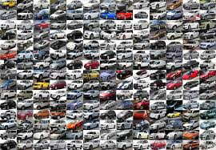
196 Car Classes
8,144 Car Training Images 8,041 Domestic Grosses
Stanford Car Dataset

Slide 5
2. Exploratory Data Analysis

Slide 6
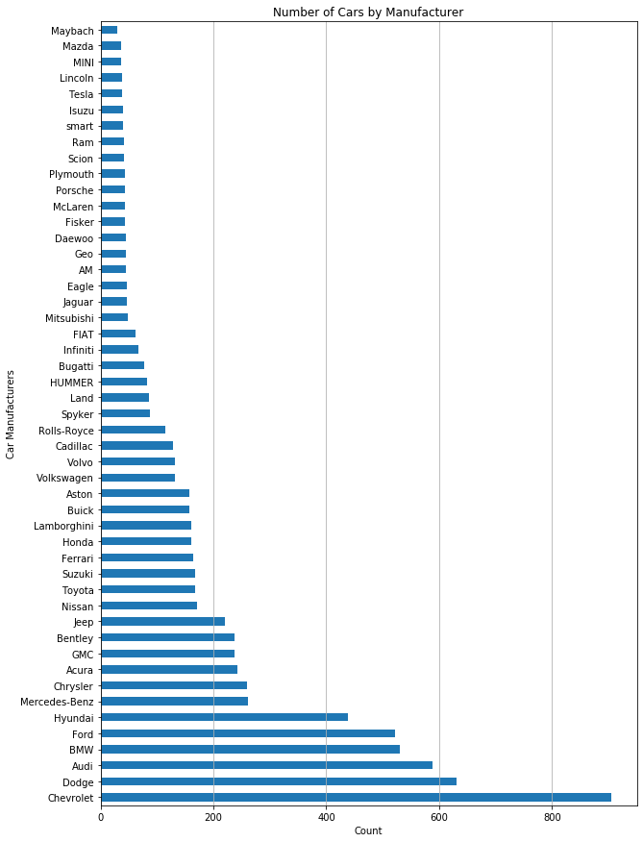
Visualizations

Slide 7
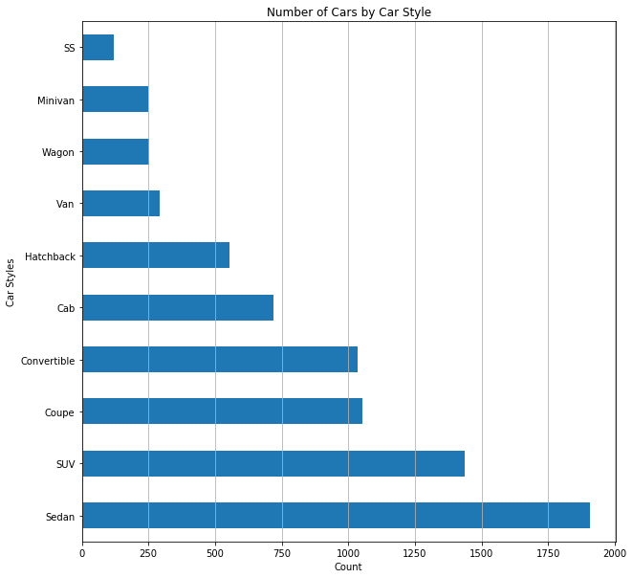

Slide 8
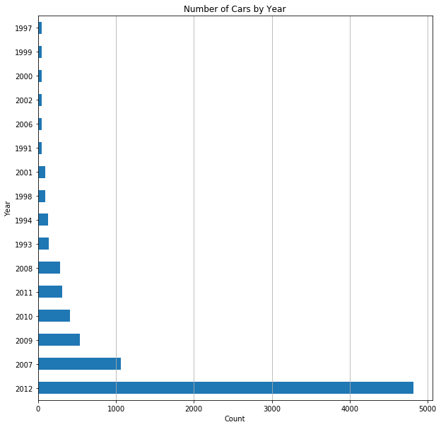

Slide 9
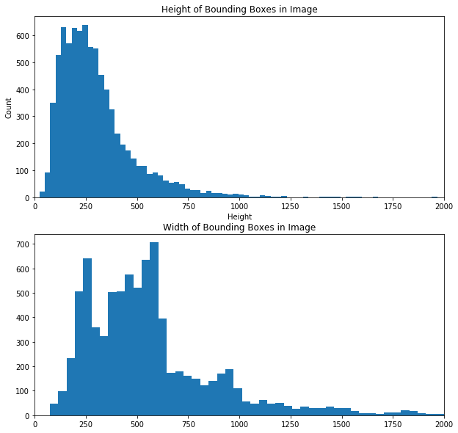

Slide 10
3. Predictive Modelling

Slide 11
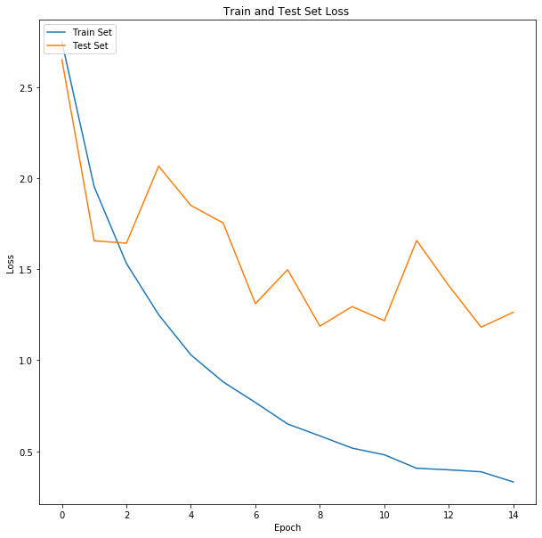
Inception V3
Results

Slide 12
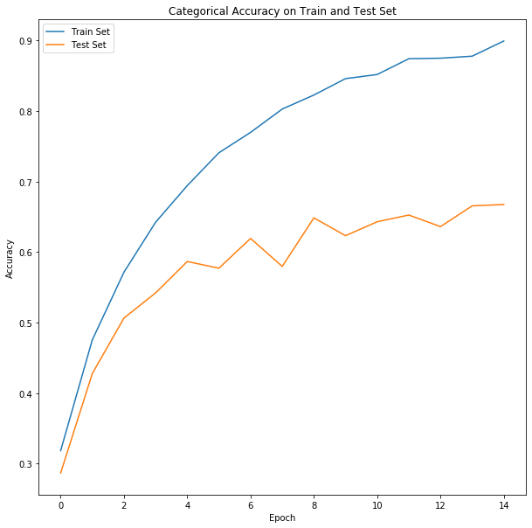

Slide 13
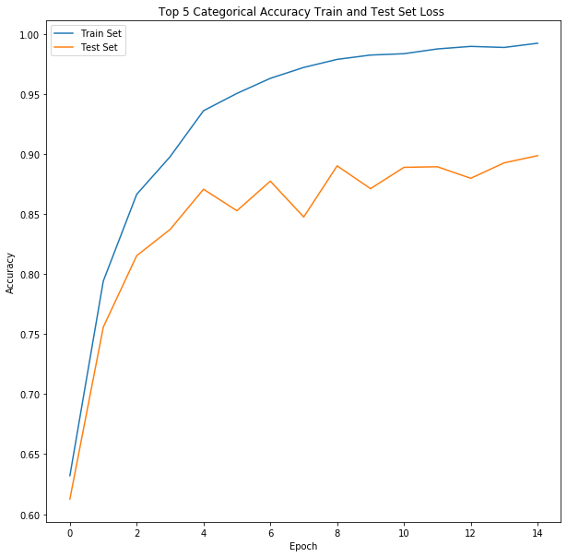

Slide 14
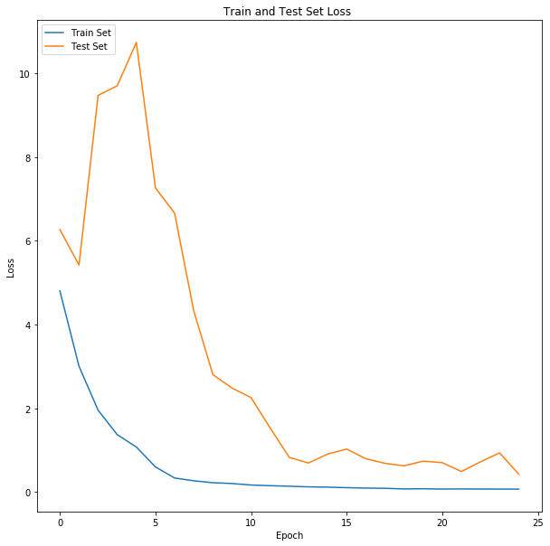
MobileNet
V2
Results

Slide 15
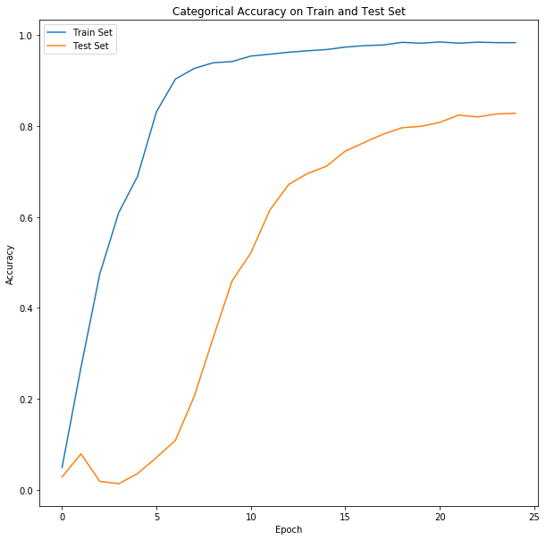

Slide 16
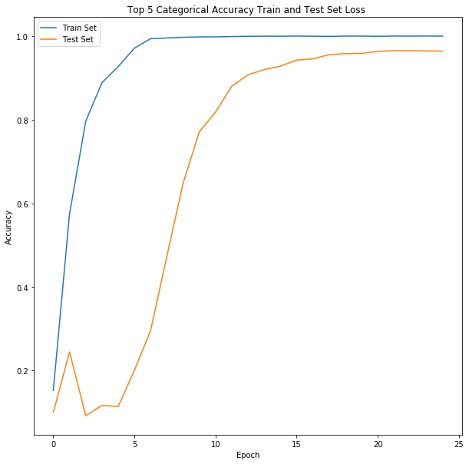

Slide 17
0.578 Validation Loss 82.8% Validation Accuracy 96.4% Top Five Validation Accuracy
Final Model Performance

Slide 18
Conclusion
MobileNet V2 pretrained model performed the best on given dataset
Both pretrained models improved performance when layers were trainable
Predictive Model correctly identified over 82 percent of unseen images
In future the neural network can be improved with more modern car data provided particularly for car manufacturers under represented in the original dataset.

